Slide 1
Cifra Palace
The Art Nouveau miracle in Kecskemét

Slide 2
Apartment, shop, casino
One of the most beautiful buildings in the main square of Kecskemét is the Cifra Palace.
It was built in 1902-1903 based on the plans of Géza Márkus.
It was originally built as a residential building in Art Nouveau style. It also had apartments, shops and a casino.

Slide 3
Cifra palace
The facade wall plane is decorated with colorful majolica.
Its decoration is characterized by a wealth of folk art motifs.
The two-story facade has a wavy finish.
It has a decorative design and a high top.
The glazed facade decorations and roof tiles were made by the Zsolnay porcelain factory (Pécs).

Slide 4
The Kecskemét Gallery
The Cifra Palace has housed the Kecskemét Gallery since 1983.
Permanent and temporary exhibitions of painters and sculptors can be seen here.

Slide 5
The Kunbábonyi gold find
Thousands of years of rich men's gold finds - this is also located in the Cifra Palace

Slide 6
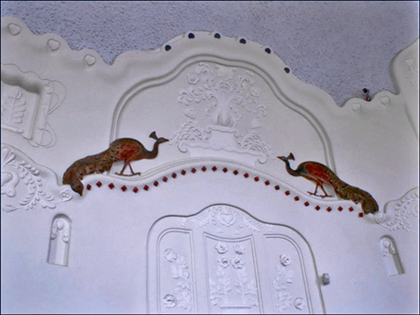
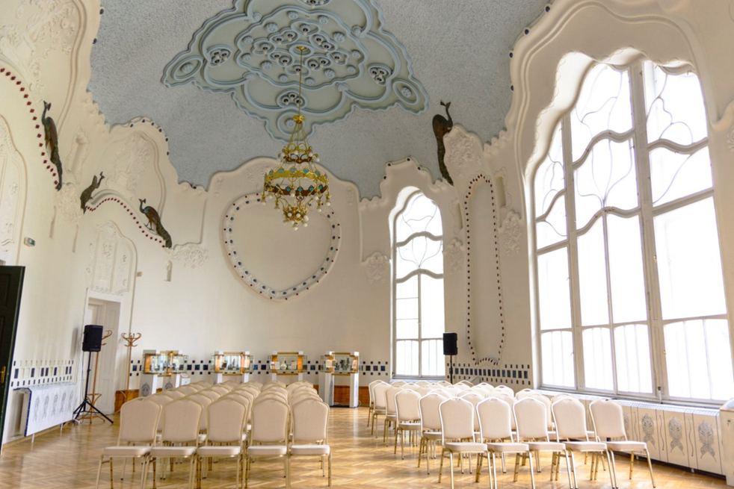
Peacock Hall (The ceremonial hall of the Cifra Palace)

Slide 7
Cifra Palace song
Listen to the children's song beginning with Cifra Palace:
https://www.youtube.com/watch?v=ZMHTHeECW_0

Slide 8
The lyrics of the Cifra Palace children's song are in Hungarian and English
Cifra Palace
its window is green
come out you tuba rose!
Viola is waiting.
I'm small
I will grow up
for a year or two
I will be a big girl.

Slide 9
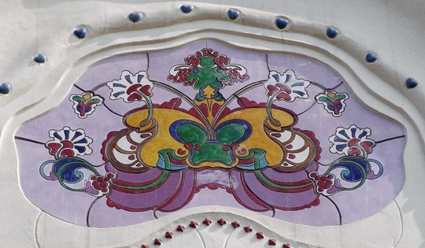
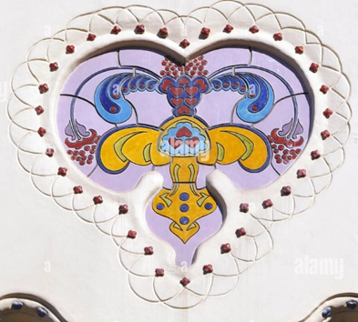
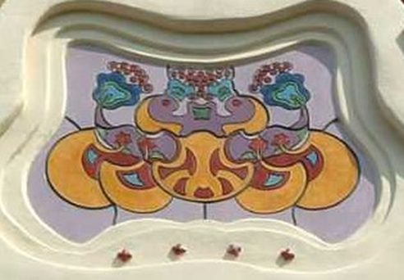
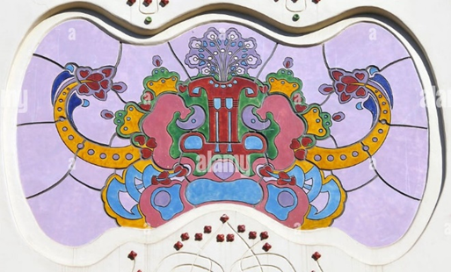
The 3rd class from the Piarist school in Kecskemét warmly welcomes everyone
The third graders copied the folk motifs on the Cifra Palace building for you! Good job on coloring!

